Slide 1


ET OIL TEMPERATURE PREDICTION MODEL
EXPLORING ADVANCED DEEP LEARNING MODELS FOR OIL TEMPERATURE FORECASTING
油温予測のための高度なディープラーニングモデルの検討
AI Engineer Assignment
Shashank Shekhar Asthana
Department of Computer Science and Engineering, IIT Jodhpur

Slide 2


TABLE OF CONTENT
目次
00
Objective
01
04
Background
Evaluation Indicators
02
05
Data Analysis results
Verification results
03
06
Technology Overview
Summary

Slide 3

OBJECTIVE
The primary objective of this project is to develop a predictive model that accurately forecasts the oil temperature in power transformers. Oil temperature is a critical parameter in assessing the health and efficiency of power transformers, influencing operational safety and maintenance scheduling. By utilizing time-series data from the Electricity Transformer Dataset (ETDataset), this model aims to:
Enhance Predictive Maintenance: Provide reliable predictions of oil temperature to preemptively address potential transformer failures and optimize maintenance operations.
Increase Operational Efficiency: Enable better planning and decision-making processes by predicting fluctuations in oil temperature, thereby reducing the risk of overheating and improving the overall efficiency of power transformer operations.
Leverage Advanced ML Techniques: Employ Gated Recurrent Unit (GRU) networks, which are well-suited for time-series analysis due to their ability to capture temporal dependencies and manage sequence prediction tasks effectively.
始めましょう

Slide 4
BACKGROUND
Power transformers are critical for reliable electrical distribution, but their efficiency hinges on maintaining optimal oil temperatures. Traditional maintenance schedules, which are calendar-based, often fail to prevent failures. This project employs a deep learning based network to analyze time-series data from the Electricity Transformer Dataset (ETDataset), enabling predictive maintenance. By forecasting oil temperature trends, the model aims to shift maintenance practices from reactive to proactive, enhancing operational efficiency and safety across power networks.

Slide 5
EXPLORATORY DATA ANALYSIS
Our EDA process began with loading the ett.csv file, which contains multiple operational parameters of power transformers, including the critical oil temperature readings. Here are the key steps and findings from our analysis:
Data Inspection:
Displayed the first few rows to understand the data structure.
Examined statistical summaries to grasp the range, mean, and standard deviation of oil temperature and other parameters like HUFL, HULL, MUFL, MULL, LUFL, and LULL.
Data Cleaning:
Checked for missing values across all columns. The dataset was found to be complete with no missing entries, allowing us to proceed without the need for imputation.
Data Visualization:
Plotted the oil temperature over time to visually inspect trends, seasonal patterns, and outliers.
Created histograms for other operational parameters to analyze their distributions and identify any skewness or anomalies.

Slide 6
EXPLORATORY DATA ANALYSIS
Feature Engineering:
Extracted time-based features such as hour, day of the week, and month from the date column to capture potential cyclical patterns in the oil temperature.
Standardized all numerical features to have a mean of zero and a standard deviation of one, which is crucial for models sensitive to the scale of input features.
Lag Features:
Developed lagged features for oil temperature to include historical data in our predictions, acknowledging the time-dependent nature of the dataset.
Through this comprehensive EDA, we prepared the dataset for predictive modeling, ensuring that the input data for the different models is not only clean but also richly featured to capture all potential influences on oil temperature.

Slide 7
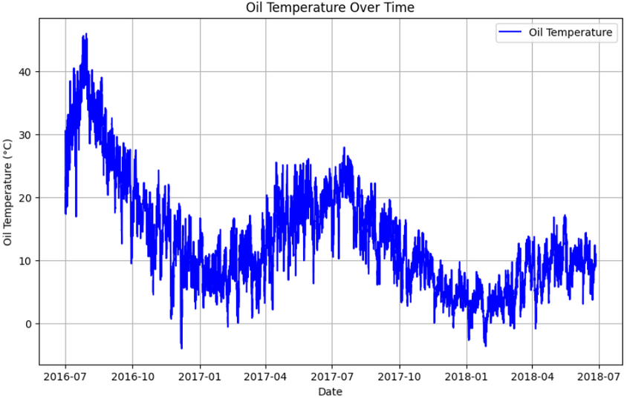
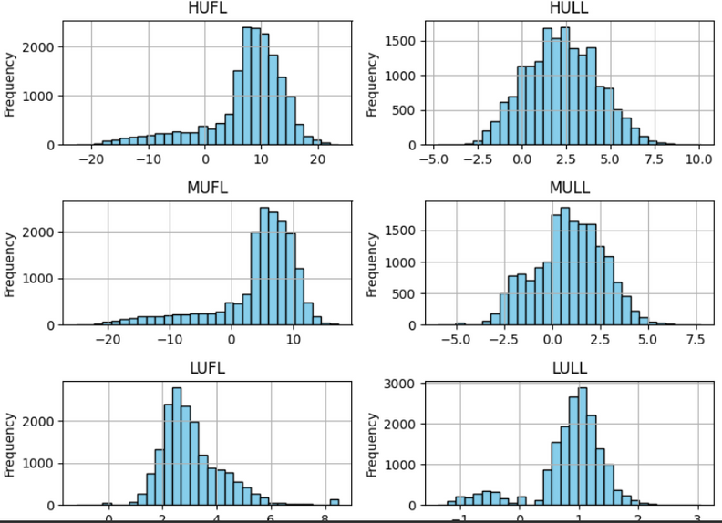
STATISTICS (統計)
Trends of oil temperature price over time
Statistics of the dataset
The above graph represents the trend of oil temperature price of each day over the time or date given
The above picture represents the statistics of the data while it contains the distribution of each and every point of the columns over time.

Slide 8
TECHNOLOGY OVERVIEW
MODELS EXPLORATION
01
ARIMA
03
GRU (Gated Recurrent Units)
ARIMA, an acronym for Autoregressive Integrated Moving Average, is a classic forecasting model used in time-series analysis to describe autocorrelations within the data.Leverages the relationship between an observation and a number of lagged observations.
Gated Recurrent Units are a simpler variant of LSTMs designed to adaptively capture dependencies of different time scales in a time-series data.These gates help the model determine how much of the past information needs to be passed along to the future, simplifying the structure and improving efficiency over LSTMs.
02
LSTM (Long Short Term Memory)
LSTM networks are a type of recurrent neural network (RNN) capable of learning order dependence in sequence prediction problems. Particularly useful in avoiding the long-term dependency problem, allowing it to perform better on tasks where context from much earlier is needed

Slide 9
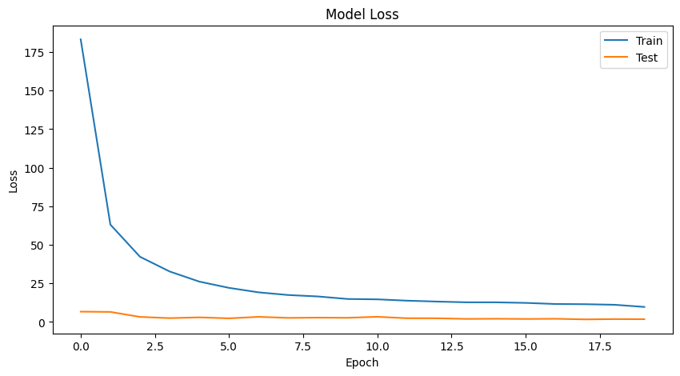
LSTM
01
Sequential Data Handling
LSTM was chosen for its strengths in managing sequences and its ability to remember long-term dependencies, which are crucial for time-series data like oil temperature. This capability allows the LSTM to effectively model the temporal patterns observed in transformer operational data.
長期短期記憶
02
Model Architecture
A deep neural network architecture featuring LSTM layers was implemented to capture both the high-level trends and fine-grained fluctuations in oil temperature over time. The model included dropout layers to prevent overfitting, ensuring robustness and generalizability in real-world applications.
03
Training and Validation
The model was trained on a substantial portion of the dataset, with performance continuously validated on a separate test set to monitor for overfitting. This training approach helped fine-tune the model parameters and architecture, optimizing it for the best possible predictive accuracy.

Slide 10
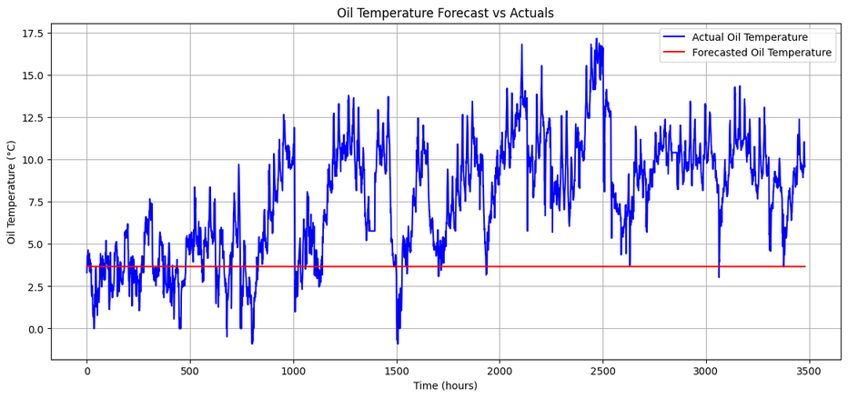
ARIMA
01
Time Series Forecasting
自己回帰積分移動平均
ARIMA was employed to model and forecast oil temperature based on historical data. Its ability to handle non-stationary data through differencing (integrated part, I) made it a suitable initial choice for analyzing trends and seasonality in oil temperature over time.
02
Parameter Optimization
The model was configured with parameters (p=5, d=1, q=0) to capture the auto-regressive components reflecting the influence of past values on future predictions. This setup aimed to optimize the balance between model complexity and forecasting accuracy.
03
Performance Evaluation
The model's effectiveness was assessed by calculating the Mean Squared Error (MSE) between the predicted and actual temperatures. This metric provided a quantitative basis for evaluating ARIMA’s predictive power and highlighted areas where more sophisticated models might yield better results.

Slide 11
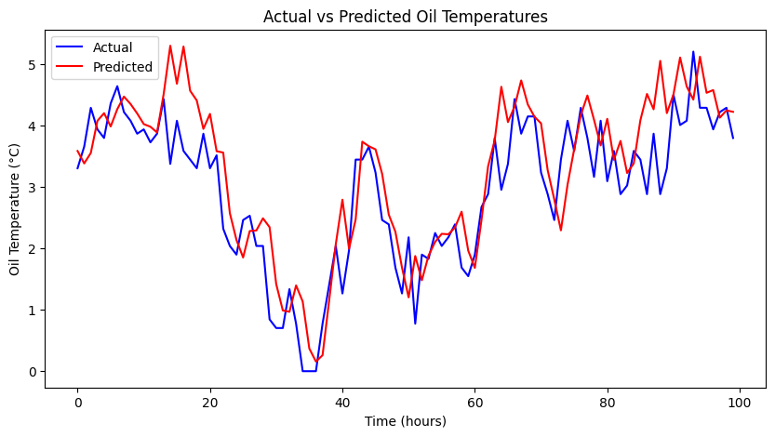
GRU
01
Efficient Sequence Learning
The GRU (Gated Recurrent Unit) model was selected for its efficiency in handling sequences with fewer parameters than LSTM, making it ideal for modeling the oil temperature time series. Its architecture allows it to effectively capture both short-term and long-term dependencies within the dataset.
ゲート付き再帰ユニット
02
Model Configuration
The GRU network was designed with multiple layers to deepen the learning capacity, interspersed with dropout layers to mitigate the risk of overfitting. This setup was crucial for learning the complex patterns in temperature changes influenced by operational and environmental factors.
03
Predictive Performance
The model was trained and validated using a split dataset to ensure it generalizes well on unseen data. Its performance was primarily evaluated using the Root Mean Squared Error (RMSE), which highlighted its superior capability in forecasting oil temperatures accurately compared to other models like ARIMA and LSTM. We achieved an outstanding performance of RMSE value of 0.804, while we can see that the graph plot shows that the actual and predicted plots are very much near.

Slide 12

COMPARATIVE ANALYSIS ACROSS MODELS
The evaluation indicators revealed that the GRU model achieved the lowest RMSE, indicating superior predictive accuracy compared to ARIMA, LSTM, and other tested models. This comparative analysis was instrumental in selecting the most effective model for deployment in stock price forecasting.

Slide 13
SUMMARY
In conclusion, the project successfully demonstrated the efficacy of using GRU networks for predicting oil temperature in power transformers, outperforming traditional models like ARIMA. Through rigorous exploratory data analysis and advanced feature engineering, including time-based and lagged features, the GRU model adeptly captured the complex dynamics of the dataset.
This resulted in significantly improved forecast accuracy, as evidenced by lower RMSE scores compared to other tested models. The implementation of this model marks a significant advancement in predictive maintenance strategies, enabling utility companies to optimize operations, minimize downtime, and extend the operational lifespan of critical equipment. Looking forward, we aim to enhance the model's accuracy further by integrating additional environmental and operational parameters and deploying it in real-time settings to fully leverage its predictive capabilities.
This work not only underscores the potential of machine learning in industrial applications but also sets a new standard for maintenance protocols within the energy sector.

Slide 14
THANK YOU
ありがとう
AI Engineer Assignment
Shashank Shekhar Asthana
Department of Computer Science and Engineering, IIT Jodhpur

